Slide 1
ESW Presentation
Topic-Waste Detection and Management
DATE – 14/10/24

Slide 2
OCT WEEK-3 EVALS
Team Name- Sheta Ke Kptaanz
Name of Members-
Ayush Sheta
2. Kavya Bhalodi
3. Shivam Gupta
4. Soham Sadavarte
Professor Name- Sachin Chaudhari

Slide 3
TIMELINE
1. Implementing the hardware architecture to run the model
2. Reviewing the model and striving for potential improvements
3. Uploading the model on QIDK kit via android studio

Slide 4
Weekly Progress Report
Task-1: Hardware Architecture Implementation- Tried to segregate wastes according to classification by using different waste bins with flaps whose opening and closing can be controlled by us to a larger extent.
Task-2 : Reviewing the model for scope of further improvements - Further stress tested the model on a more diverse set of waste items in different orientations. This further helped us to correct our model in case of discrepancies.
Task-3 Uploading the model on QIDK kit-
Trying to integrate our working model on the android system present in the QIDK kit using Android Studio .

Slide 5
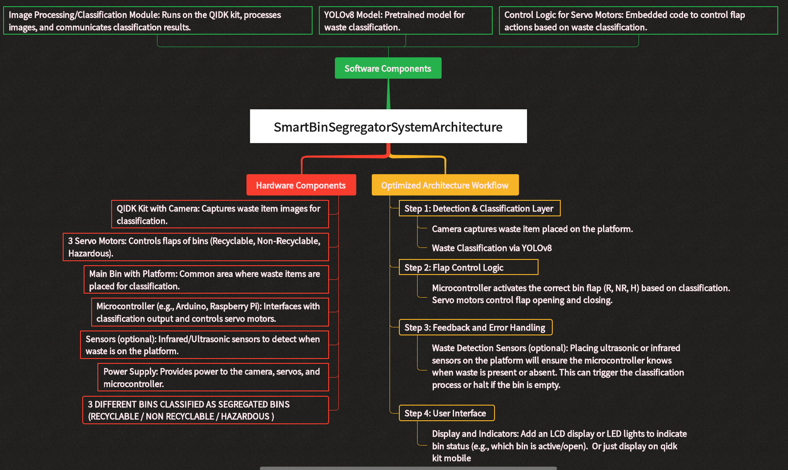

Slide 6
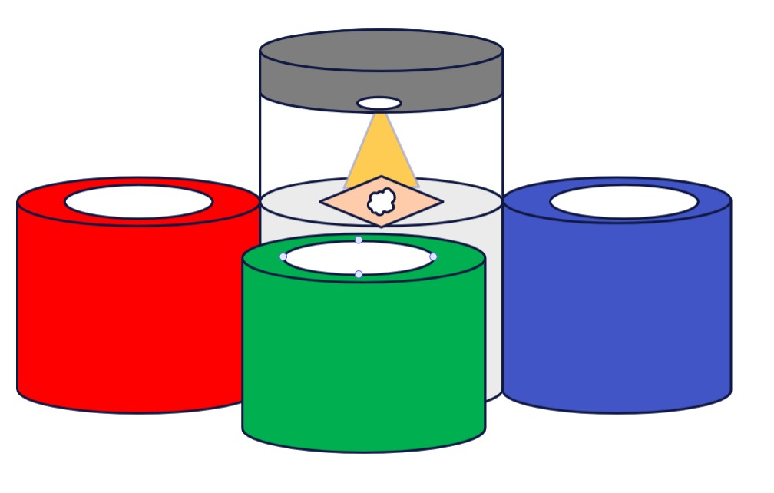
HARDWARE VISION ARCHITECHUTUE
r

Slide 7
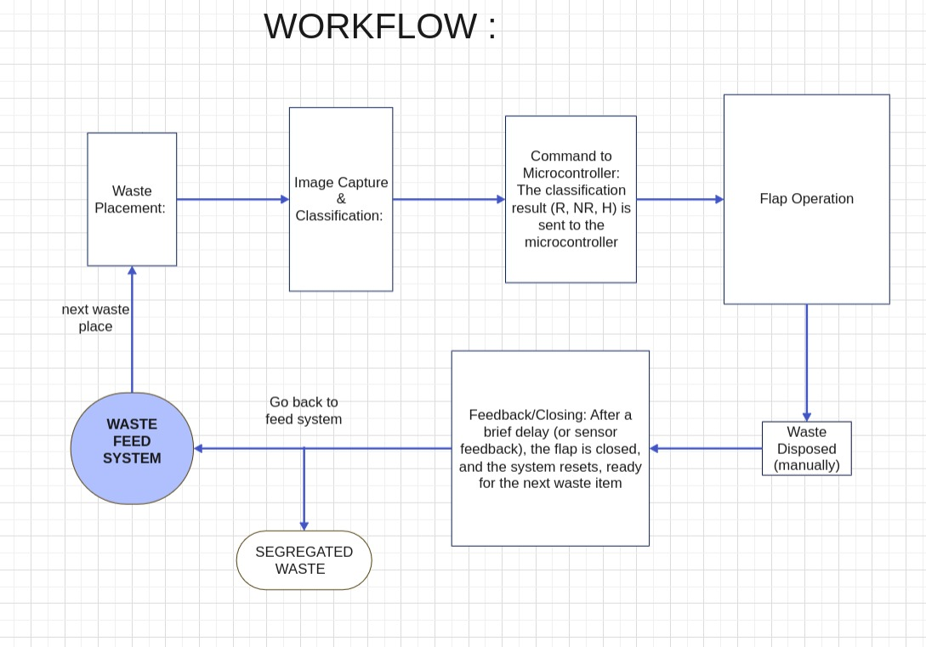

Slide 8
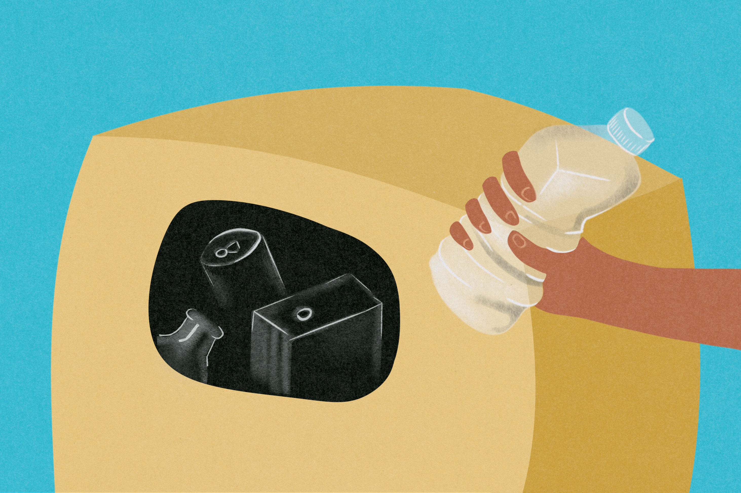
HARDWARE IMPLEMENTATION INTRICACY
The vision and core idea regarding the hardware implementation is summarized in a clear and precise manner in the flowchart given on next slide:
An insight into this leads us to conclusion that certain sensors and actuators are needed to implement the required hardware architecture. The required sensors are listed below:
1. Proximity Sensor
2. IR Sensor
3. Ultrasonic Sensor
4. Servo Motor

Slide 9
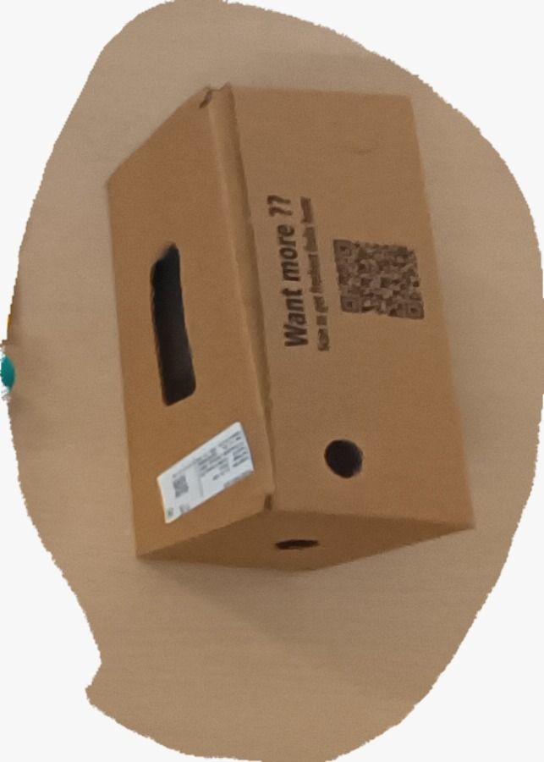
Other important tasks done this week Stress Testing the model- We stress tested our model on a diverse set of waste items comprising of different classes of articles like recyclable, non-recyclable etc and came to the conclusion that the model is precise and accurate.
r

Slide 10
Uploading the model on QIDK kit
We were able to generate the .dlc files from the corresponding .pt files. We also referred to the Vision Solutions when we surfed and examined the QIDK github repository online.
To proceed further we imported the whole abovementioned repository on anroid studio application to generate the .apk flies.
To achieve our task of generating the .apk we followed all the necessary steps described explicitly in the Vision Solutions repository in a sequential manner.
Watched relevant YouTube videos on how to set up or initialize the dataset and uploaded stored pictures.

Slide 11
Challenges Encountered and Failures
Gradle Sync Phase- Syncing the gradle package in android studio application is a necessity for successful compilation and loading of our model.
Acknowledgement Failure- Upon syncing the gradle package the successful termination message could not be retrieved thus indicating presence of potential errors in the codebase which are yet to be addressed.

Slide 12
THANK YOU !!!

